Slide 1

Legal Policy Analyser
Brand tip
Download our PowerPoint Timesaver to access hundreds of pre-designed slides with editable tables, charts, graphics and more!
Hrishikesh Venkatakrishnan
M Barath Vikraman
25th July 2025

Slide 2
Problem Statement
Extract structure from MeitY legal PDFs (laws, rules, sections).
PDFs may be uploaded or scraped from https://meity.gov.in.
Output must ignore Hindi and summarize only English content.
Avoid LLM-based summaries.
Final output is a python class file modeling sections and rules.

Slide 3
Core Challenges
Scraped PDFs are inconsistently structured (headings/bullets).
Mixed-language (English + Hindi) content.
No reliable way to compare summaries of different acts manually.
LLM chunking slows down summaries and is now replaced.
Non LLM models need to be able to exclusively scrape only significant data.

Slide 4
Solution Architecture — Backend
PyMuPDF + Regex: Extract English-only structured text
Subsection/Rule Detection: Handles 4.1, bullets, a), etc.
Class File Generator: Writes python class file per legal PDF
Comparison Logic (optional): Detects changes between two acts
Playwright + BeautifulSoup: Scrape MeitY PDFs automatically

Slide 5
Output Format (Python Classes)
@dataclass
class LegalAct:
title: str
sections: List[Section]
@dataclass
class Section:
number: str
title: str
rules: List[Rule]

Slide 6
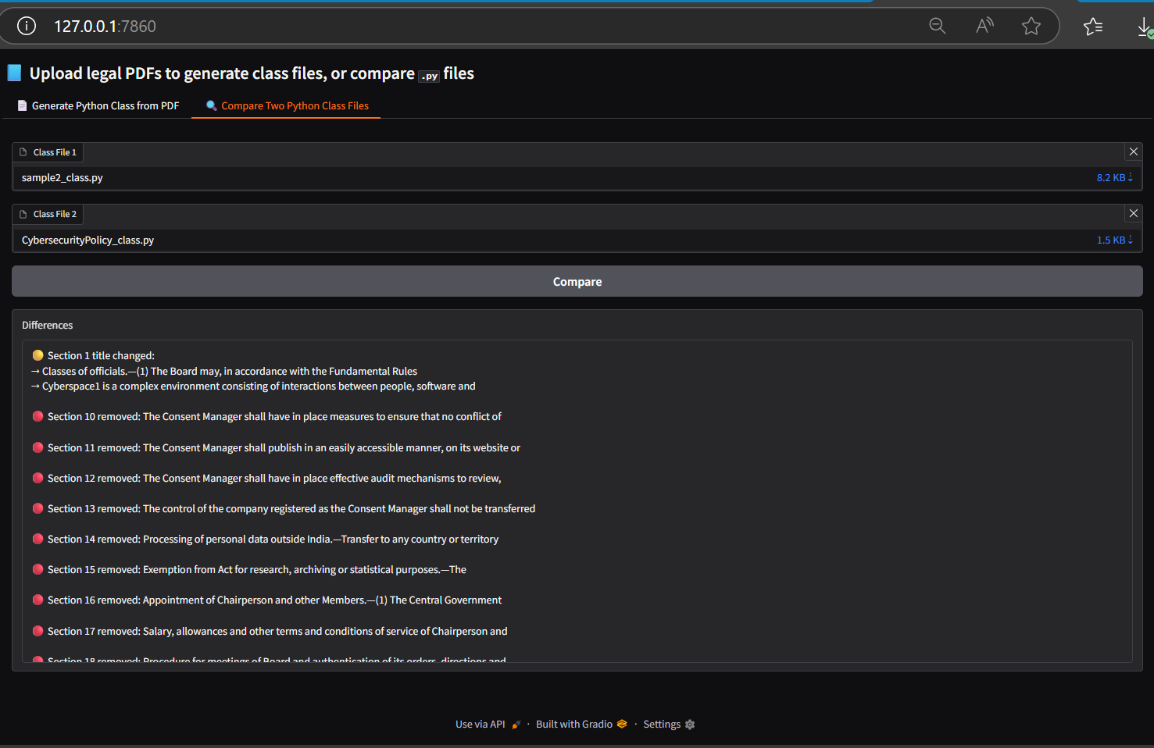
Solution Architecture — Frontend
Gradio UI with mode toggle (Upload/Compare). Supports upload of multiple PDFs at a time. Display summary and downloadable PDF.

Slide 7
Limitations of the model
Manual comparison between acts is inefficient.
PDFs can be summarized with each other, but summarization formats might vary, and accuracy of the comparison might fail.
The model has a chance to miss some of the rules/articles.

Slide 8
Business Value and Use Case
Enables programmatic legal analytics
Supports tracking rule changes over time
Can build comparison engines using Python
Avoids ambiguous summaries → ensures exact structural diff.

Slide 9
Future Scope
Tag sections as added/modified/removed
Track compliance impact per section
Extend to other policy repositories (RBI, TRAI)
Attempt at scaling this to government policies of other countries to efficiently parse legal documents worldwide.

Slide 10


Team
M Barath Vikraman
Hrishikesh Venkatakrishnan
Intern
Intern

